Slide 1
AT- Knowing the Basics
Joan Breslin Larson M.Ed.
Breslin Larson and Associates
joanbreslinlarson@gmail.com

Slide 2
About this discussion…
Conversation is welcome!
Share your resources and ideas
We cannot problem solve individual cases

Slide 3
What is Assistive Technology (AT)
Defined in federal and state law
ANYTHING that supports, maintains, increases the independence of a person with a disability
The services that support the selection, acquisition and use of an AT device
  Training, maintenance, repair, etc.

Slide 4
AT can be used in
Education, to support access to the curriculum
Daily living, to support independence
Work, to support completion of work activities
Communication
Recreational activities

Slide 5
Education examples
Spell check
Word prediction
Laptop
Pencil grip
Calculator
Switches
Computer input devices

Slide 6
Education considerations (birth – transition)
IEP Teams MUST consider whether the student requires AT devices and services to access the curriculum
IFSP Teams consider parent’s dreams for children served under Part C
Schools must provide AT determined by IEP Team to be necessary
Schools can, with parental permission, access MA funds for some AT devices
Devices paid for with MA funds belong to the student
IDEA services stop when student graduates

Slide 7
What are good AT services?
Defined in the Quality Indicators for Assistive Technology
Grassroots community of practice with a focus on assistive technology in special education
Eight areas in which supports have been developed
Available at https://qiat.org

Slide 8
Education services in post secondary
ADA is the determining law rather than IDEA
Students should be self advocates and be able to identify what they need and why
Beginning to learn self advocacy skills and identifying supports should begin before graduation
Students should become well integrated with student support services

Slide 9
Daily living examples
Calendaring systems
Home assistants (Apple Siri, Google Virtual Assistant, Amazon Alexa, etc.,)
One handed daily living aids
Switches for environmental control

Slide 10
You can find devices
At a regular store
On Amazon or other online stores
From specialty providers

Slide 11
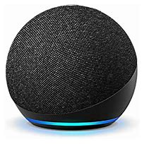
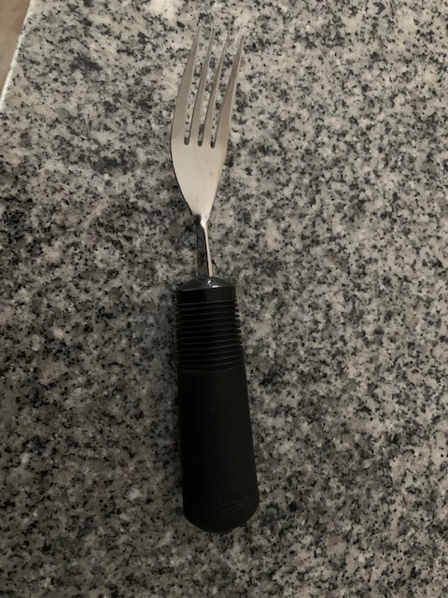
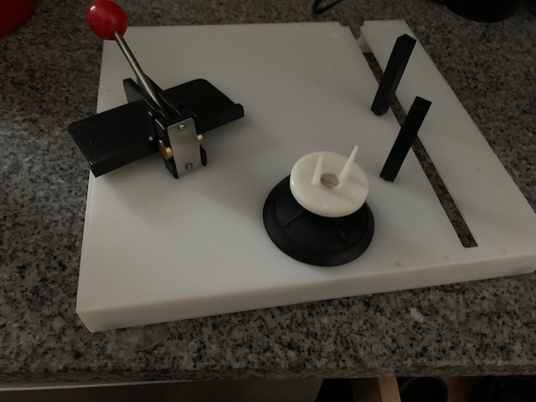
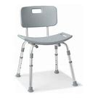

Slide 12
Work
Time and Task management
Computer access
Environmental adaptations
Communication supports

Slide 13
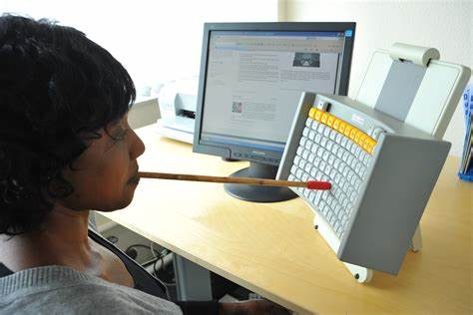
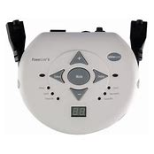
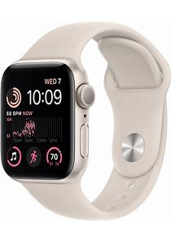
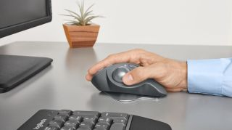

Slide 14
Federal law supports access
Americans with Disabilities Act
Minnesota Department of Employment and Economic Development (DEED) / Minnesota Department of Employment and Economic Development (mn.gov)
Minnesota STAR Program - A System of Technology to Achieve Results / STAR (mn.gov)

Slide 15
Communication
Voice output devices (simple to complex)
  Picture communication
  Single switch
  Multiple message
Think about
  Size matters
  Voice matters

Slide 16
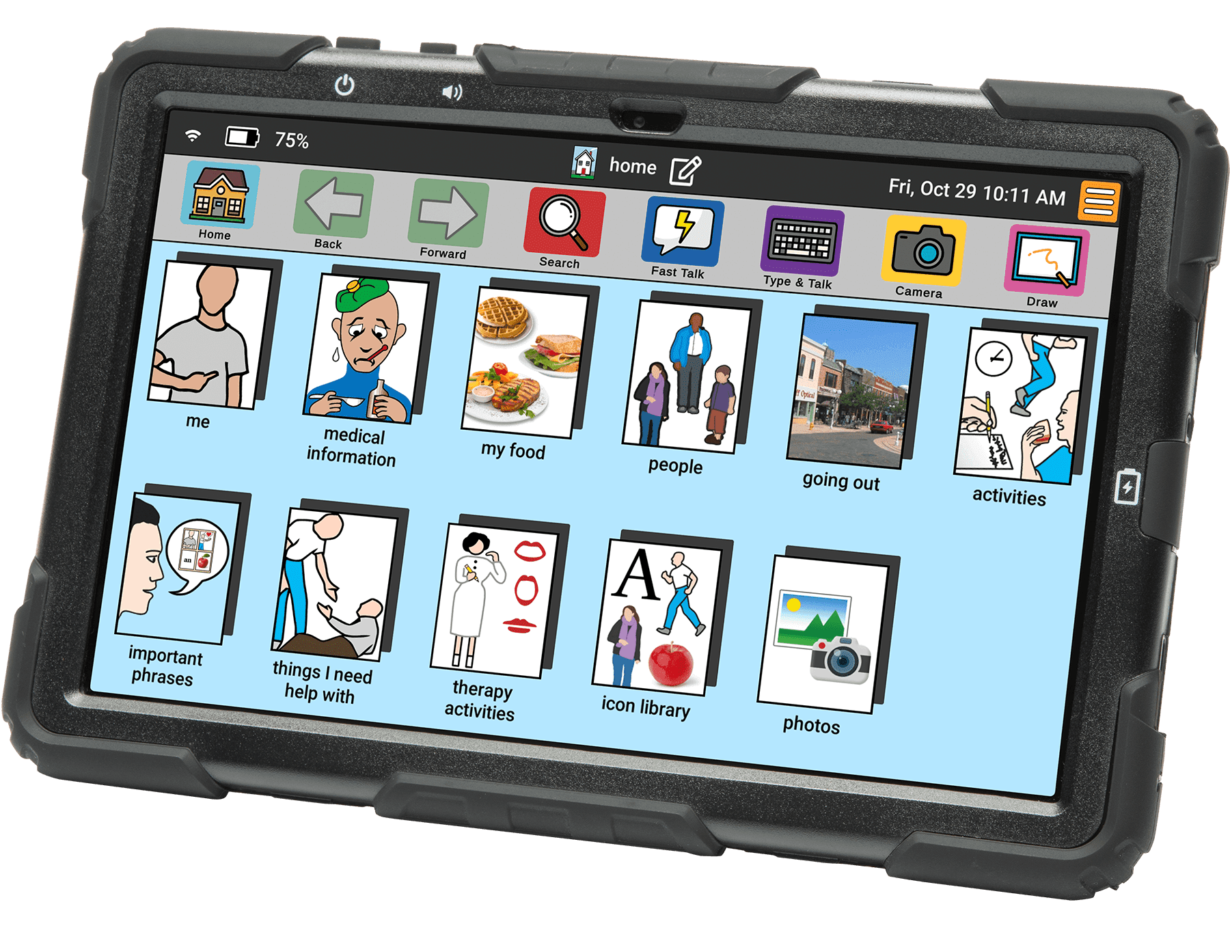
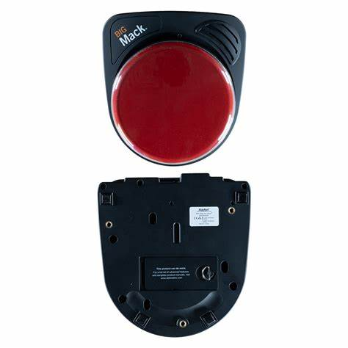
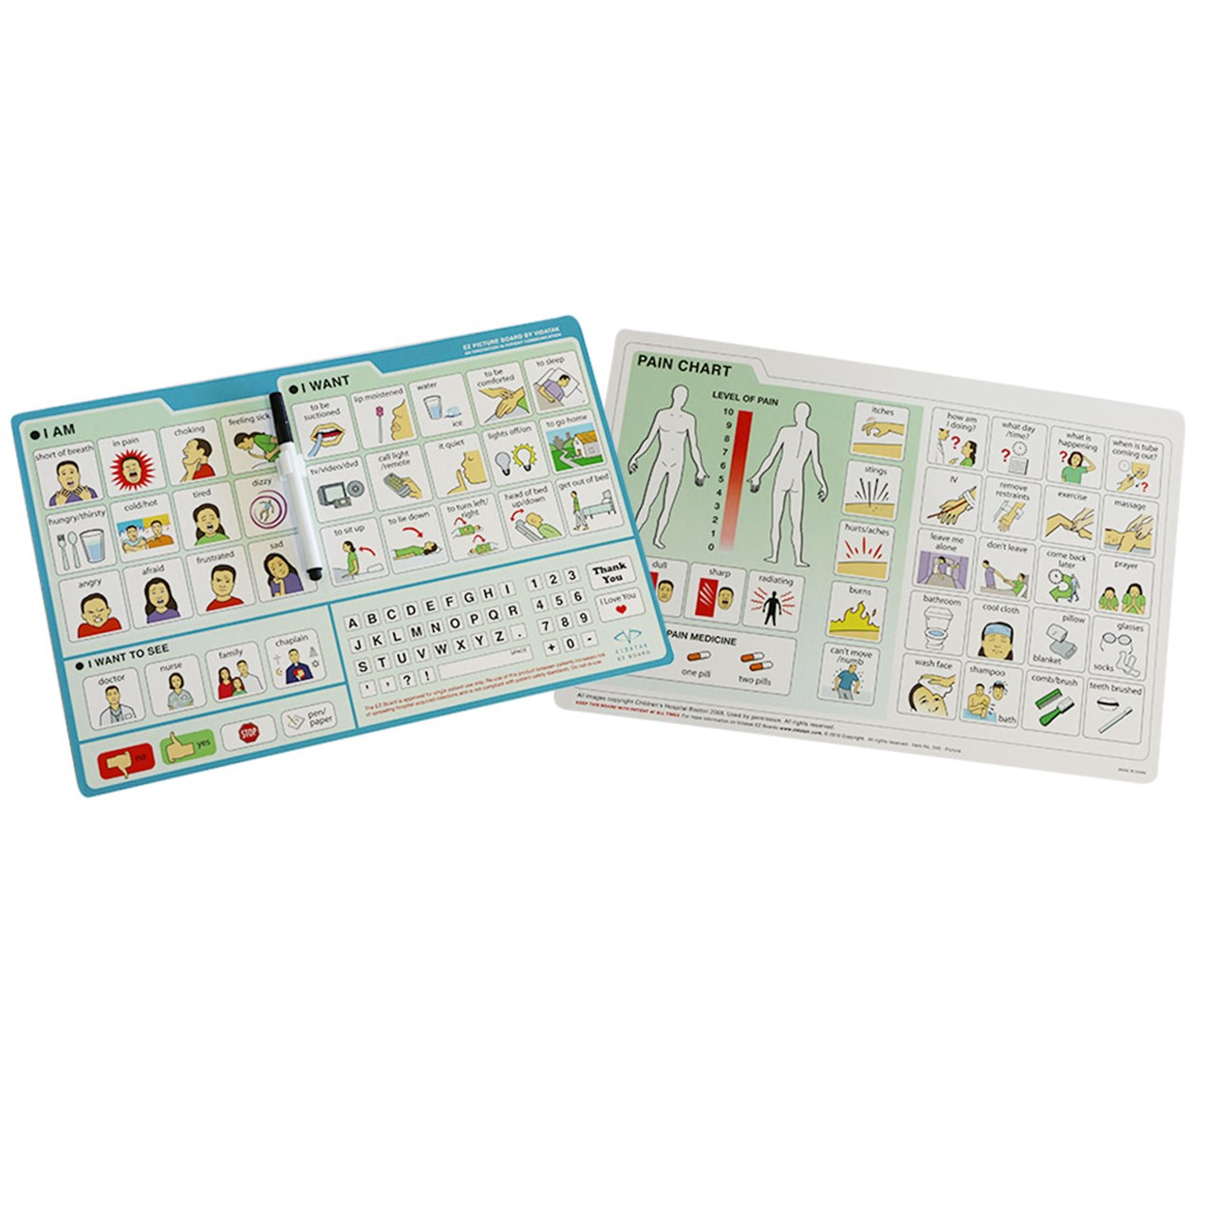

Slide 17
Recreation
Switches
Adapted sports equipment
  Commercial
  Home made
Adapted sports leagues/inclusive sports leagues

Slide 18
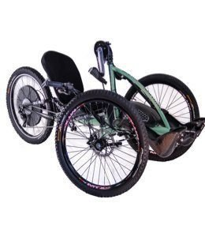
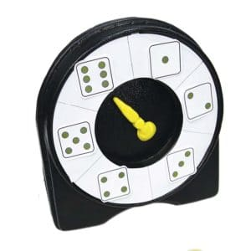
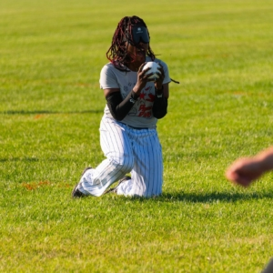
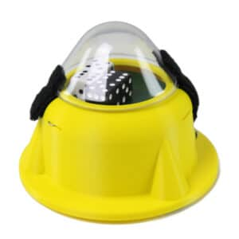
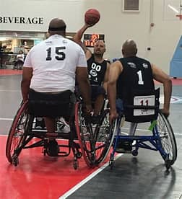

Slide 19
Recreation opportunities
Adaptive sports and recreation | Allina Health (Courage Kenney)
Local parks and recreation programs
Special Olympics
ARS (nuars.org) (Brown County)
Twin Cities Adaptive Cycling (tcacycling.org) (opening up for spring in June)

Slide 20
Minnesota Resources
Minnesota STAR Program Minnesota STAR Program - A System of Technology to Achieve Results / STAR (mn.gov)
SIMON Technology Center, Pacer.org
Technology for Home Technology for HOME – Healthy Outcomes Maximized for Everyone
Minnesota Department of Education (Kursten Dubbels is AT Specialist)
Vocational Rehab Services Find a Vocational Rehabilitation Services Office / Minnesota Department of Employment and Economic Development (mn.gov)

